Slide 1
FMAT3888 - Projects in Financial Mathematics
Monte Carlo and Finite Difference
Group 6

Slide 2
Monte Carlo

Slide 3
Monte Carlo Methods - European Call Option
S&P 500 MINI SPX OPTIONS INDEX (^XSP)
Standard Monte Carlo
Monte Carlo Antithetic
Quasi Monte Carlo
Multilevel Monte Carlo (Extension)
Importance Sampling
Control Variates

Slide 4
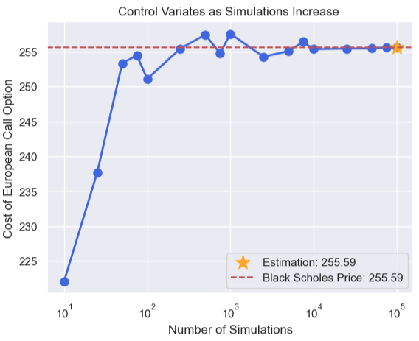
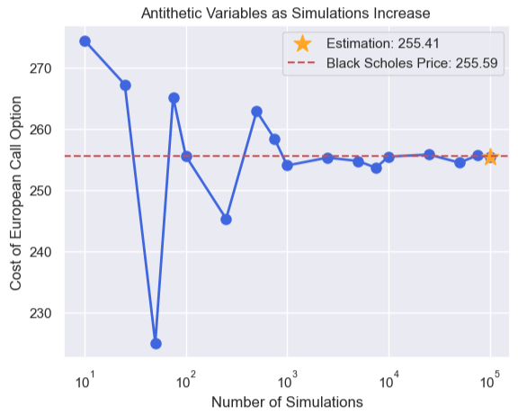
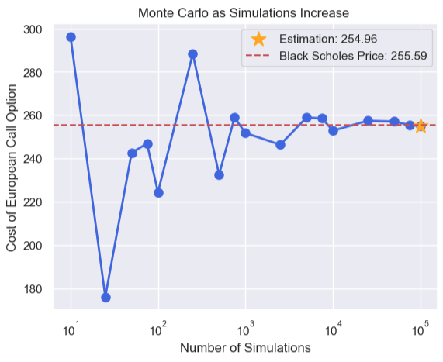
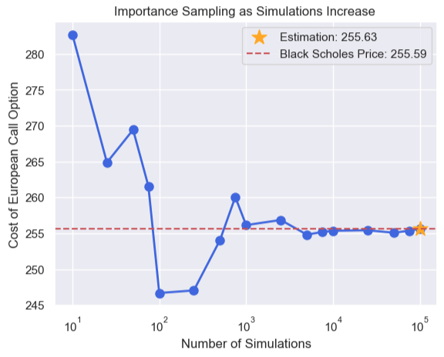
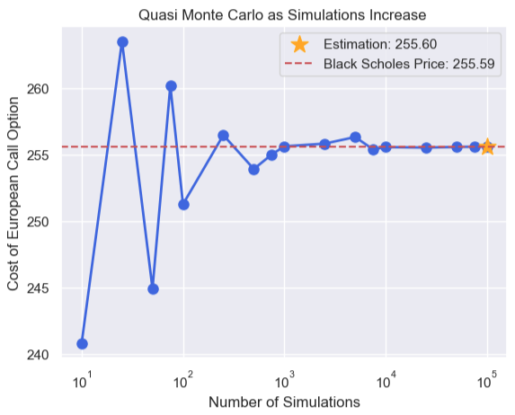
Convergence

Slide 5
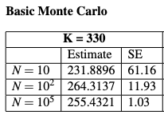
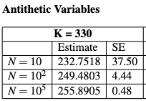
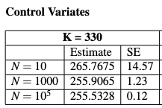
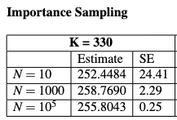
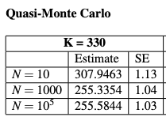
Precision and Accuracy

Slide 6
Finite Difference

Slide 7
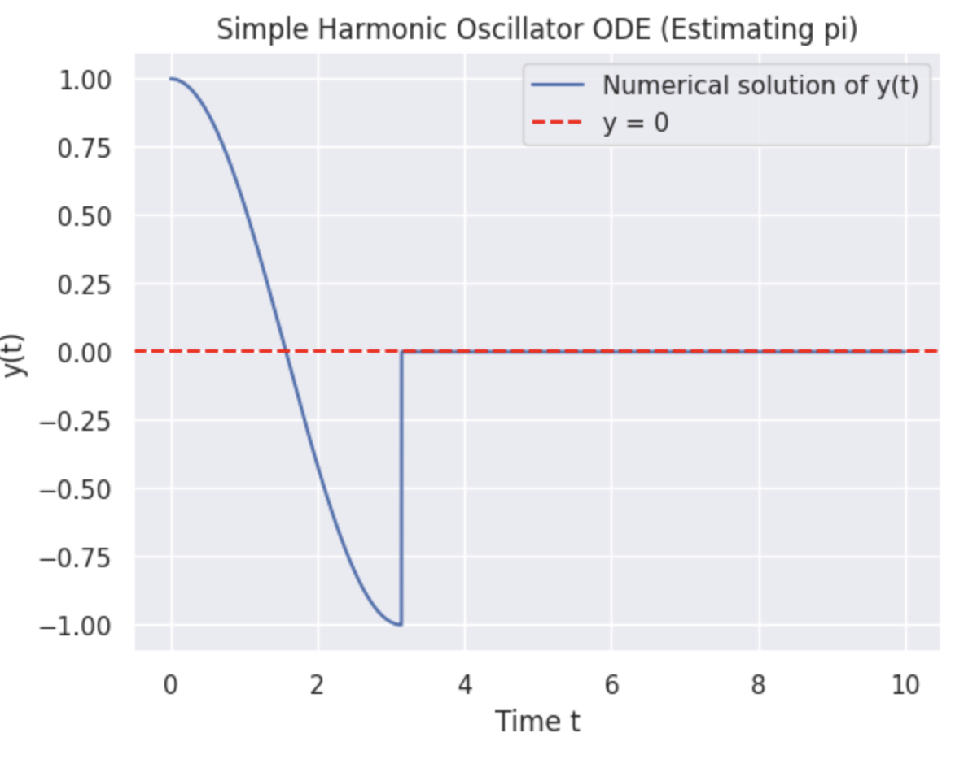
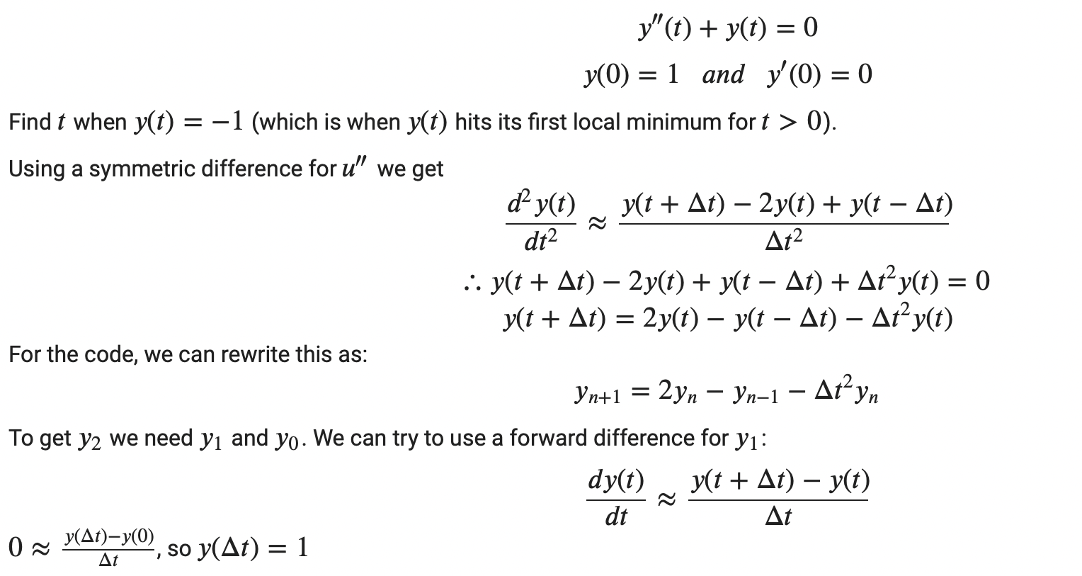
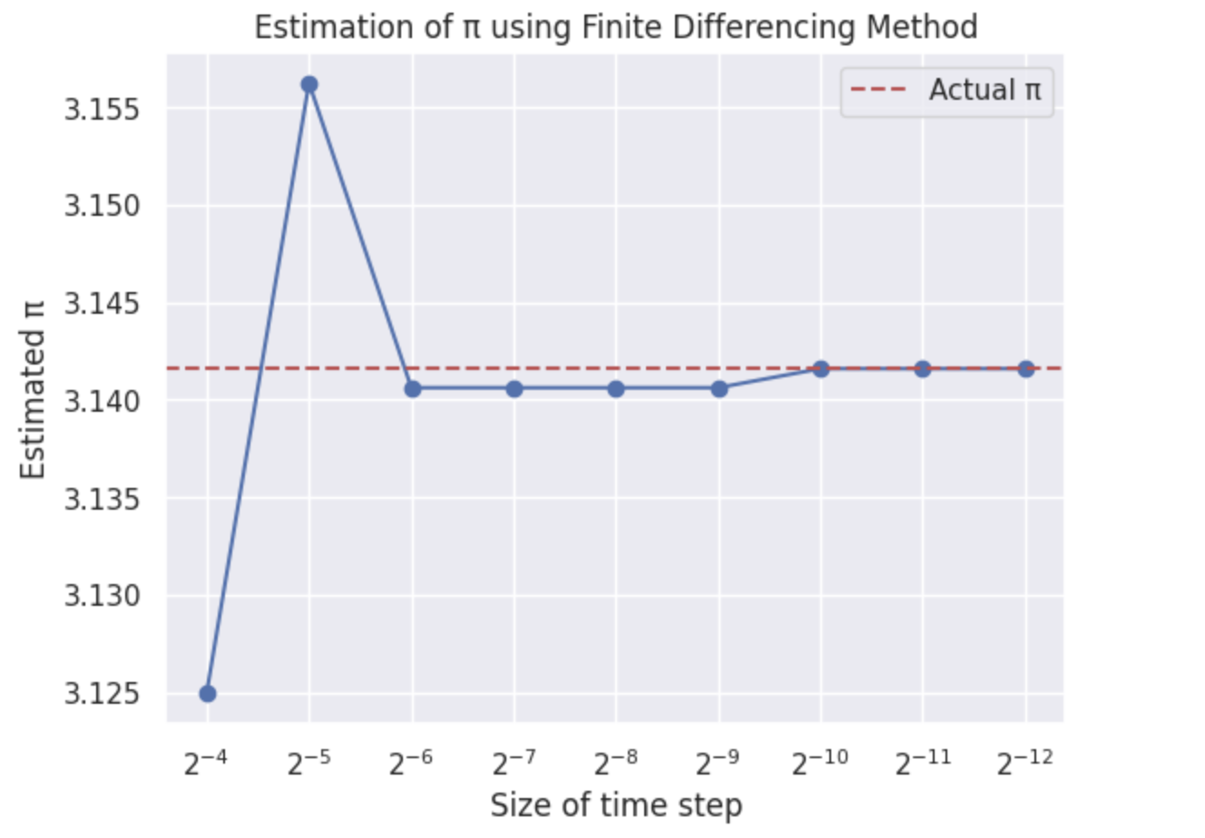
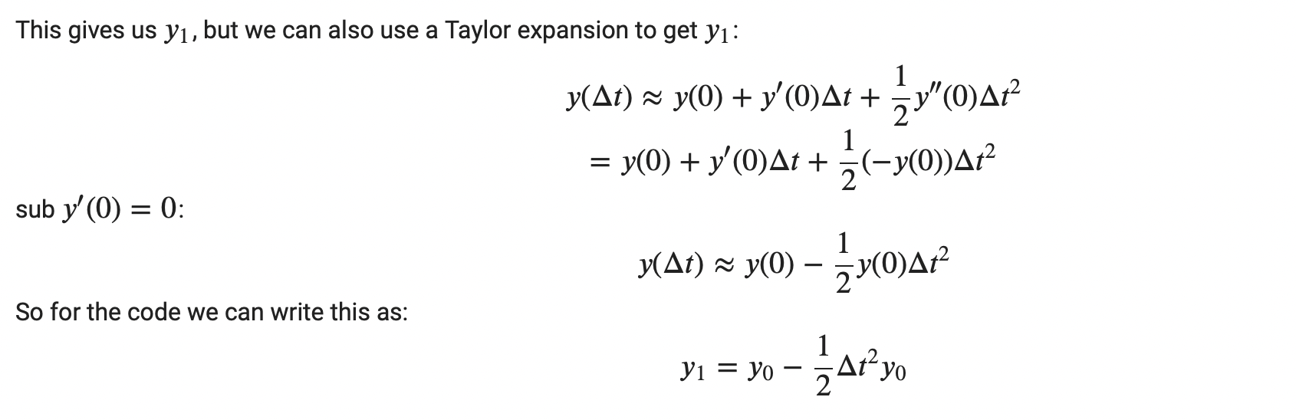
Finite Difference
Example: “Estimation of pi value”

Slide 8
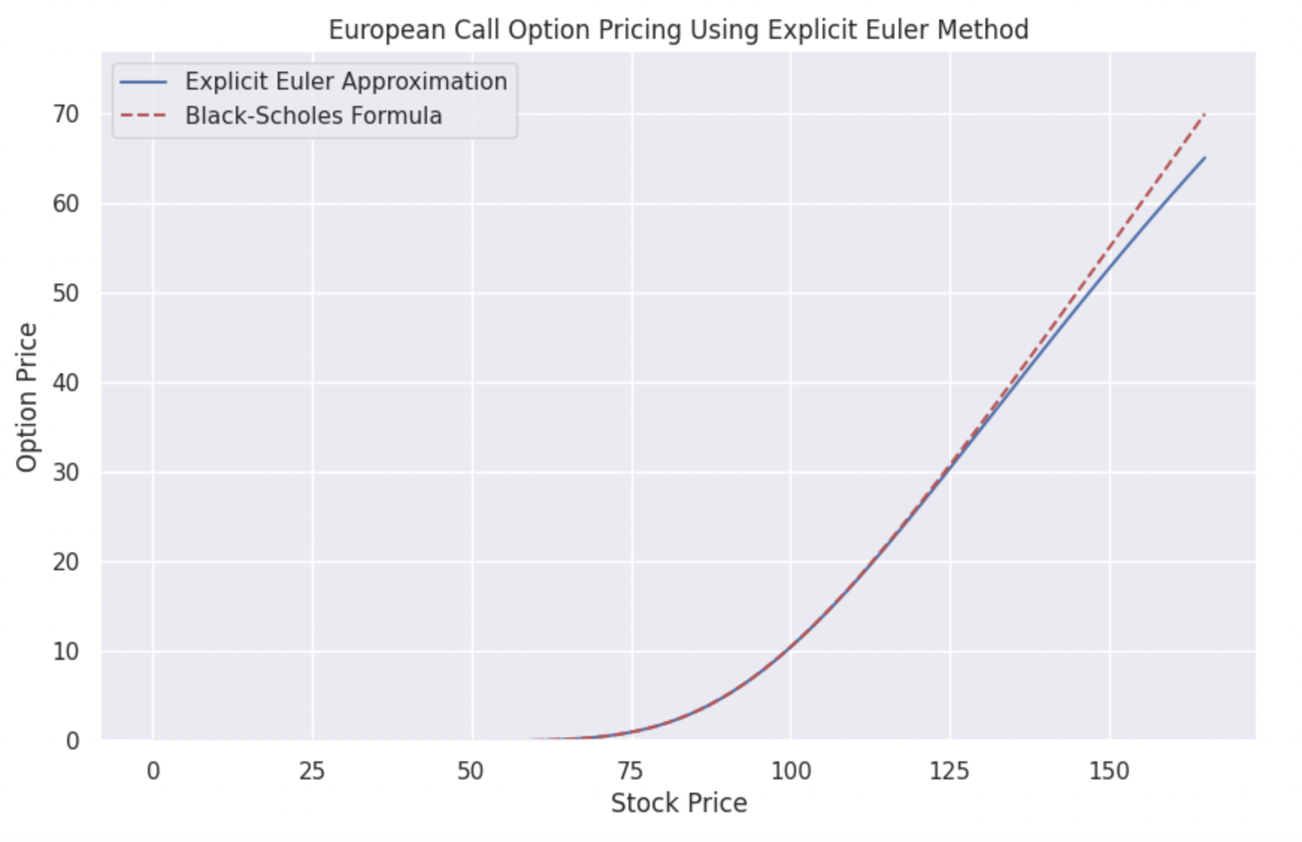
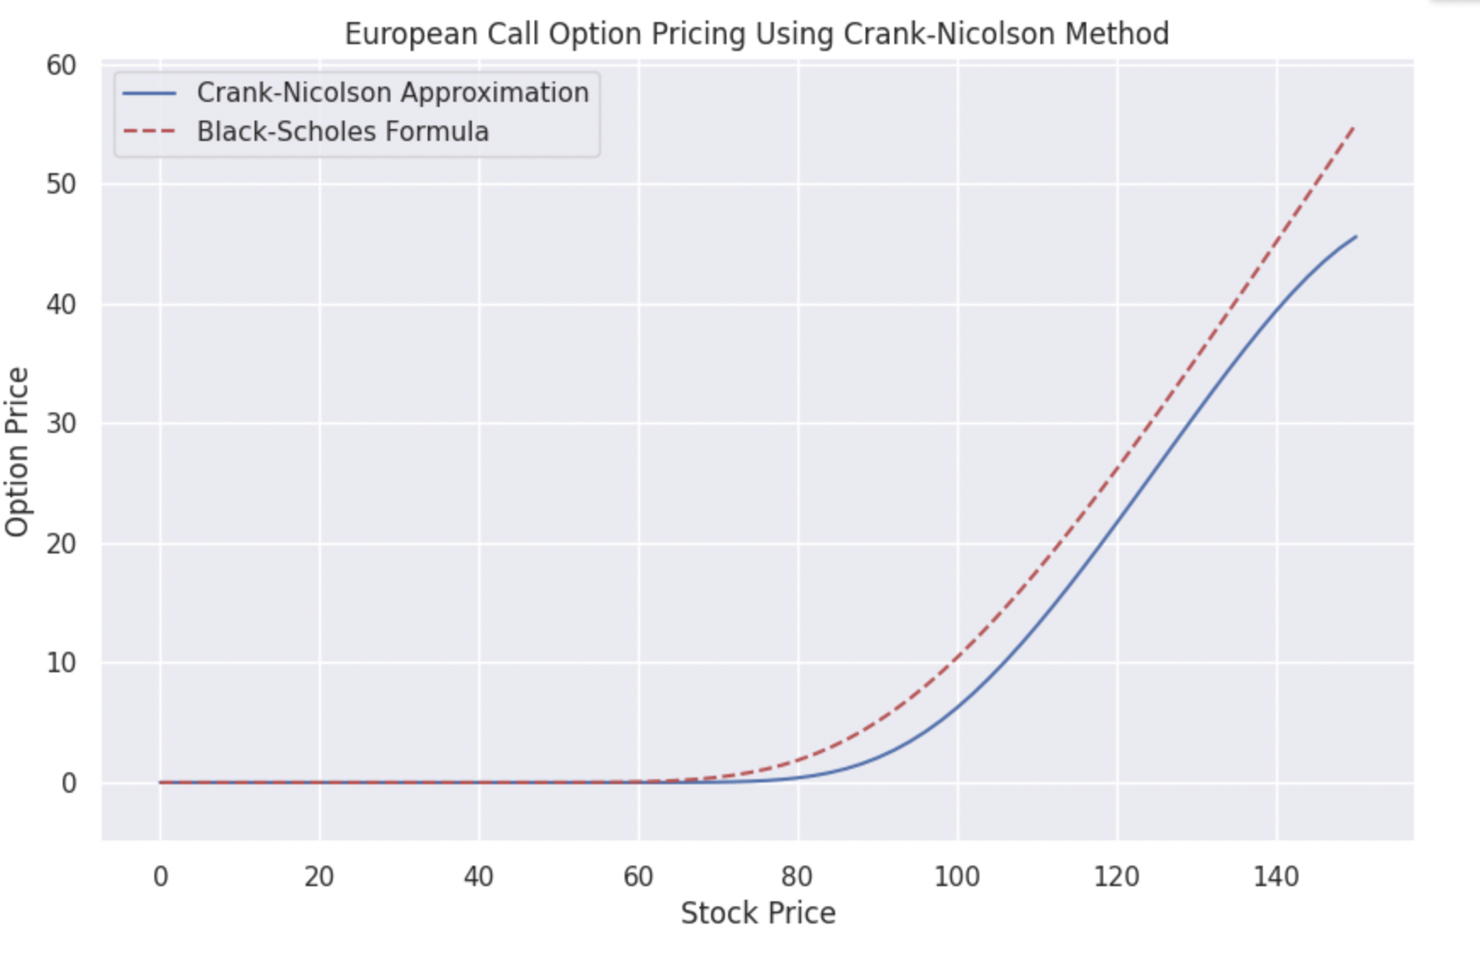
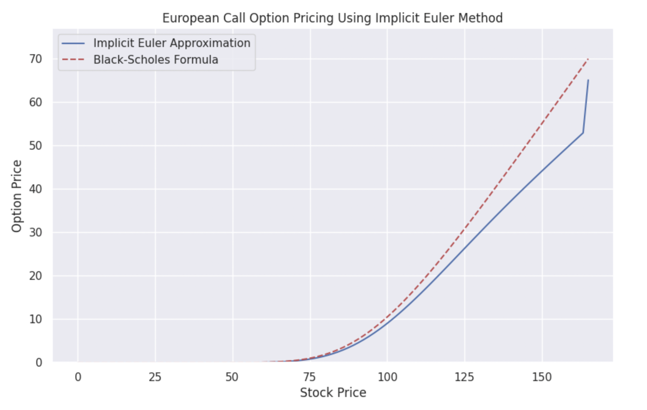
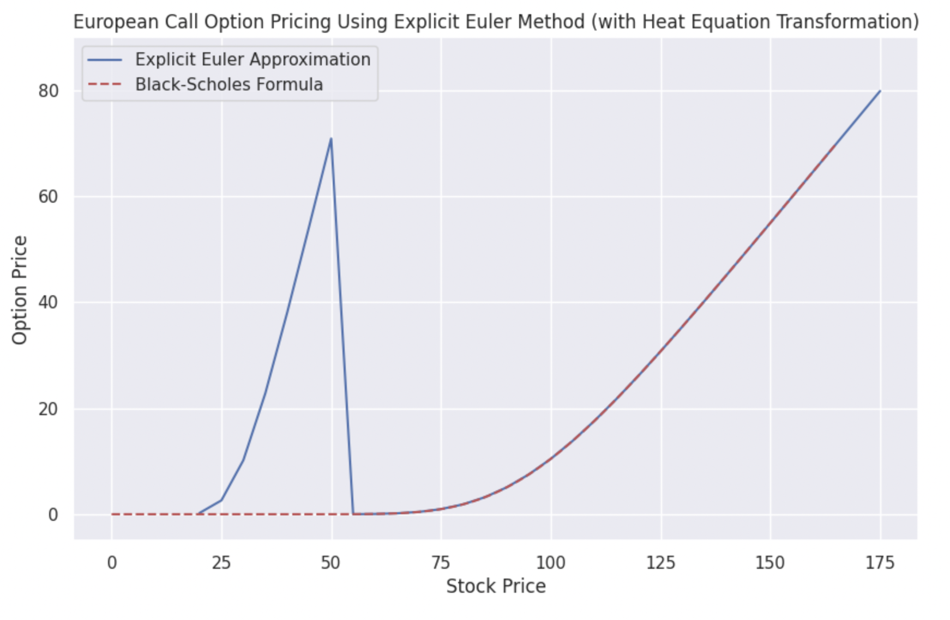
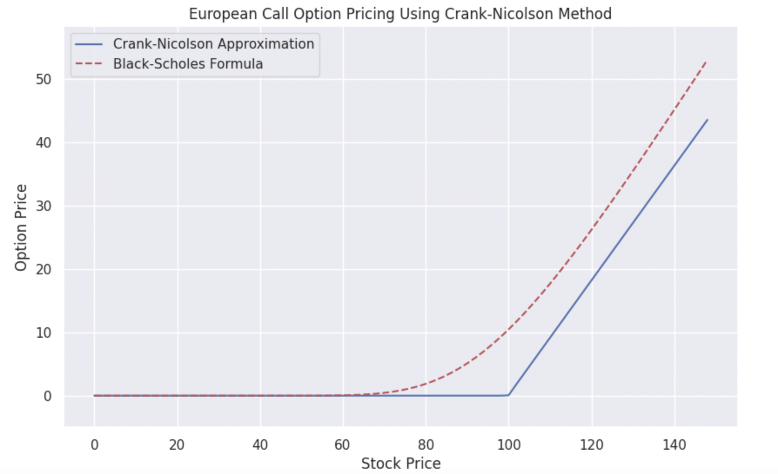
FDM on European Call PDE
Explicit
Crank Nicolson
Implicit

Slide 9
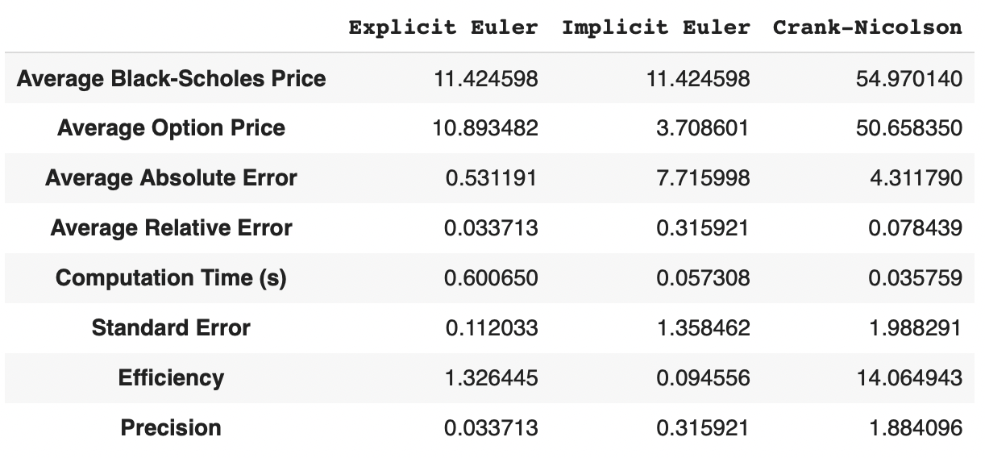
Precision and Accuracy

Slide 10
Conclusion

Slide 11
General Differences
Monte Carlo
Conceptually straightforward
Can handle complex payoffs
Can scale to higher dimensions
Finite Difference
Deterministic (no random sampling)
Faster convergence for short-term options
Solutions available for all combinations of stock prices and time steps
More computationally efficient

Slide 12

Group Findings
We found Monte Carlo easier to work with
Finite Difference initially trickier (difficulty finding the correct number of steps for both time and stock price)

Slide 13
Thank You!

